Slide 1
Corona Travel
Hackathon. Selection of the technologies’ stacks

Slide 2
Product description
Our goal is to allow users to travel online from home via any device of their liking. They'll start by opening an app or a link and choosing a desired destination. After choosing a location, users can choose to view destination in 3D, look at some 3D photos or videos or learn some facts about the place.
Team: Sofya Donskaya, system analyst; Elena Karelina, backend developer; Danil Kireev, frontend developer; Artem Filimonov, backend developer + API integrator
Repo: https://github.com/randomunrandom/corona_travel

Slide 3
A list of the stacks
A list of a stack of technologies for implementation of microservices
FastAPI (Python) + uvicorn (ASGI) + pymongo (MongoDB)
Spring Framework (Java) + Apache Tomcat + JDBC (psql)
Symphony (PHP) + Apache + MySQL
Boost (C++) + Nginx + sqlite
Express (JavaScript) + Node.js + mongojs
We decided to look at FastAPI and Spring because more team members are familiar with Python or Java than with PHP, C++ or JavaScript

Slide 4
Comparison of 2 technologies
Criteria | Stack 1 - FastAPI (Python) | Stack 2 - Spring (Java)
OBJECTIVES AND REQUIREMENTS | ASGI, automatic documentation, strong typing | asynchronous, Enterprise-grade
DEVELOPER AVAILABILITY | ¾ of developers know python and easy to learn | ½ of developers know Java
EASY TO TEST | pytest + pytest_mongo | JUnit
THIRD-PARTY INTEGRATION | Dependency injection is supported out of box, asynchronous by default | Dependency injection is supported out of box
COST | MIT License | Free (Apache 2.0 license), Java Enterprise is not free
SECURITY | Supports oauth2 with dependency injection of authlib | Supports oauth2
SCALABILITY | Easily containerized, MongoDB supports clustering | Scalability is not a standardized component within the Java EE Platform specification. The associated techniques are mostly vendor specific and often involve using more than one products
FREQUENCY OF UPDATES | Several times a month | Once a month
AGE OF TECHNOLOGY | About 10 years | About 20 years

Slide 5
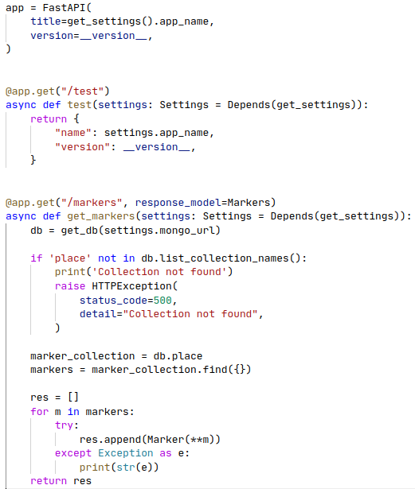
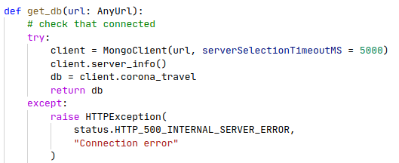
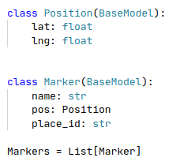
Stack 1 implementation

Slide 6
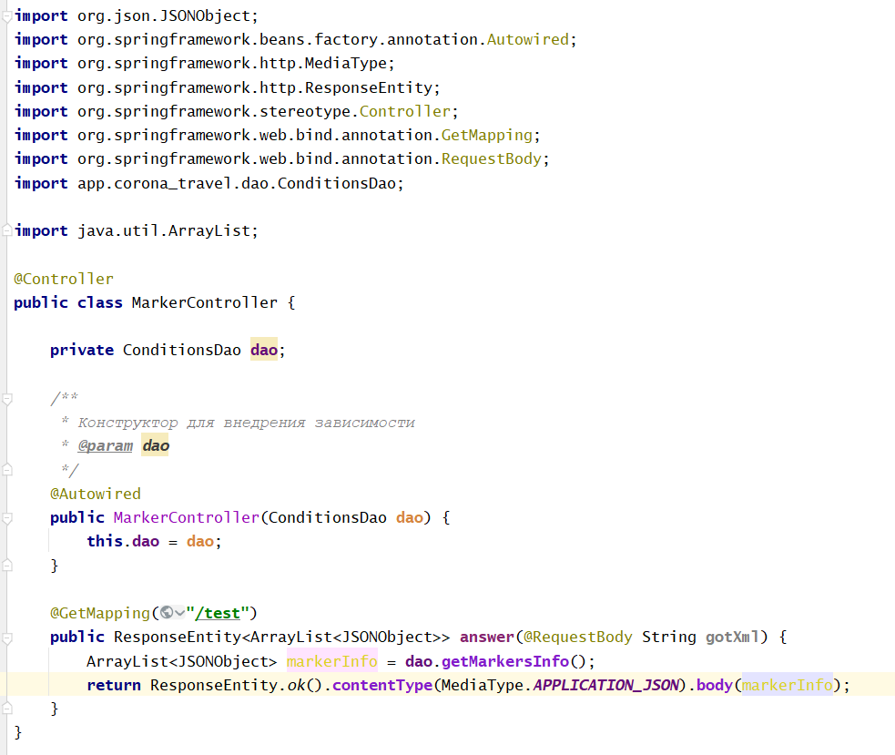
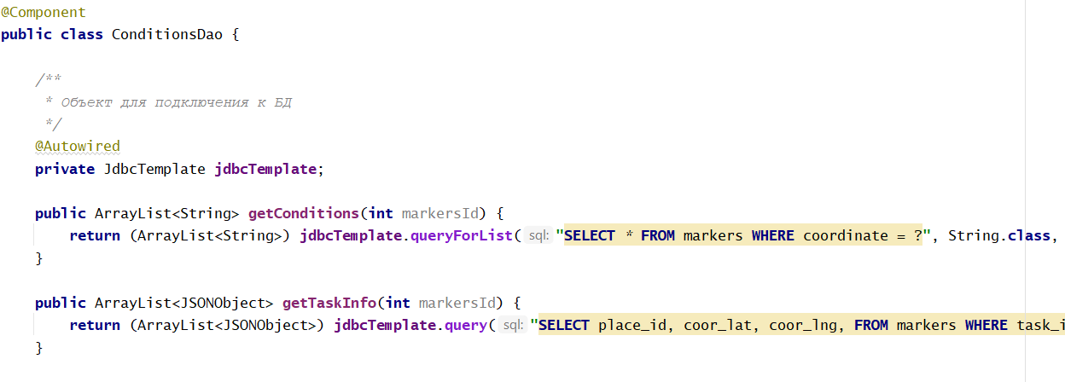
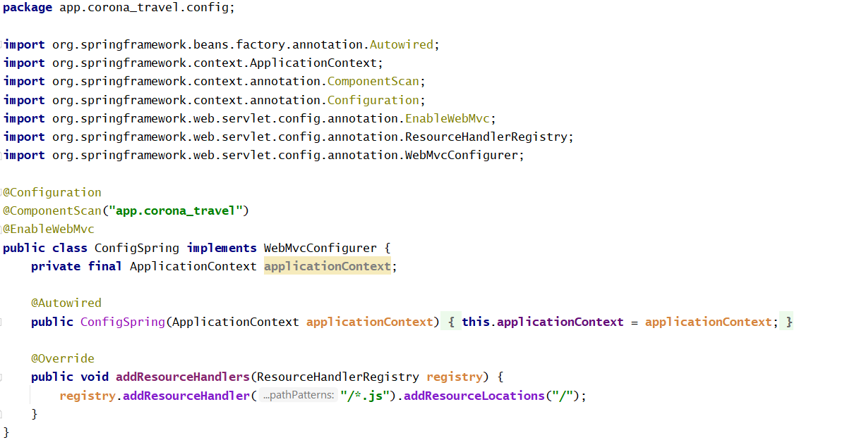
Stack 2 implementation

Slide 7
Conclusion
We decided to use FastAPI (Python) + uvicorn (ASGI) + pymongo (MongoDB) because:
More team members are familiar with python than java
Easy to implement tests
Strong Typing
Automatic documentation
Easy to write (smaller amount of lines of code)

